Slide 1
Pressure Controller
Omar Mohamed Moustafa Mohamed
Learn-In-Depth
First Term Project 1

Slide 2
Customer Specifications

Slide 3
Customer Specifications
Specifications
A pressure controller informs the crew of a cabin
with an alarm when the pressure exceeds 20 bars in
the cabin
The alarm duration equals 60 seconds.
The pressure readings may be stored for future reading

Slide 4
Case Study

Slide 5
Assumptions
Controller setup & shutdown procedures are not assumed
No maintenance model will be provided
The sensors failure case is not Assumed
The Cabin Alarm failure is not Assumed
No maintenance model will be provided
Given the User Specifications,
I assume the following:

Slide 6
Versioning System
What is missing | Due Date | Version
The ability to store sensor readings for BLACK BOX | 1/9/2023 | 1.0
N/A | 10/9/2023 | 2.0
N/A | 30/9/2023 | 3.0
Versions 3.0 + are for future updates

Slide 7
Software development & testing life cycle

Slide 8
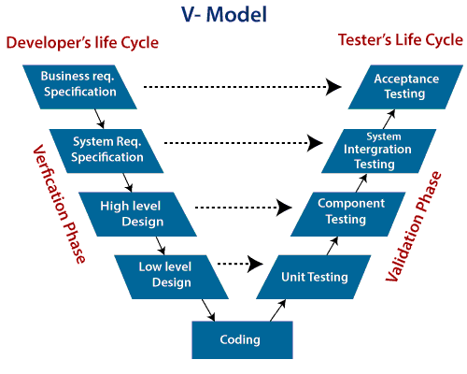

Slide 9
System requirements

Slide 10
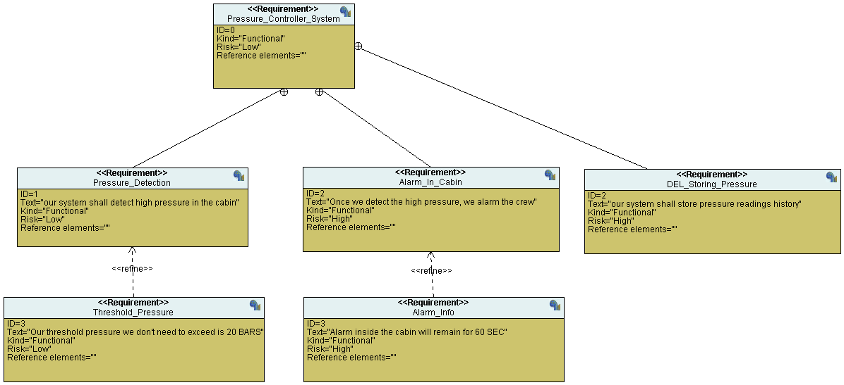

Slide 11
Software partitioning

Slide 12
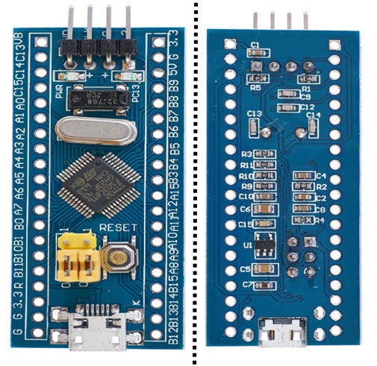
Sw_partitioning
Our software components will be best-fit over an ARM microcontroller
After some Researches, we found that stm32f103c8t6 will be most suitable
Very affordable price :180 EGP
Will be perfect for future scaling of our project
Very high speed which is much needed in our use case
Very low power consumption (ARM architecture)

Slide 13
System analysis

Slide 14
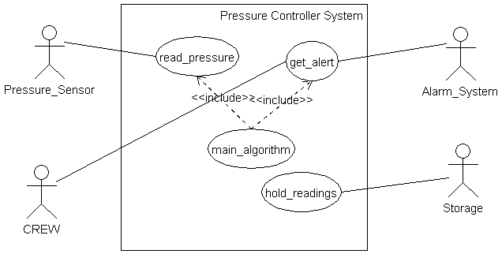
Use case diagram

Slide 15
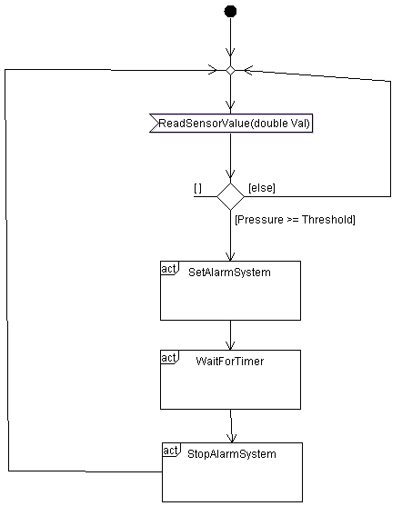
Activity diagram

Slide 16
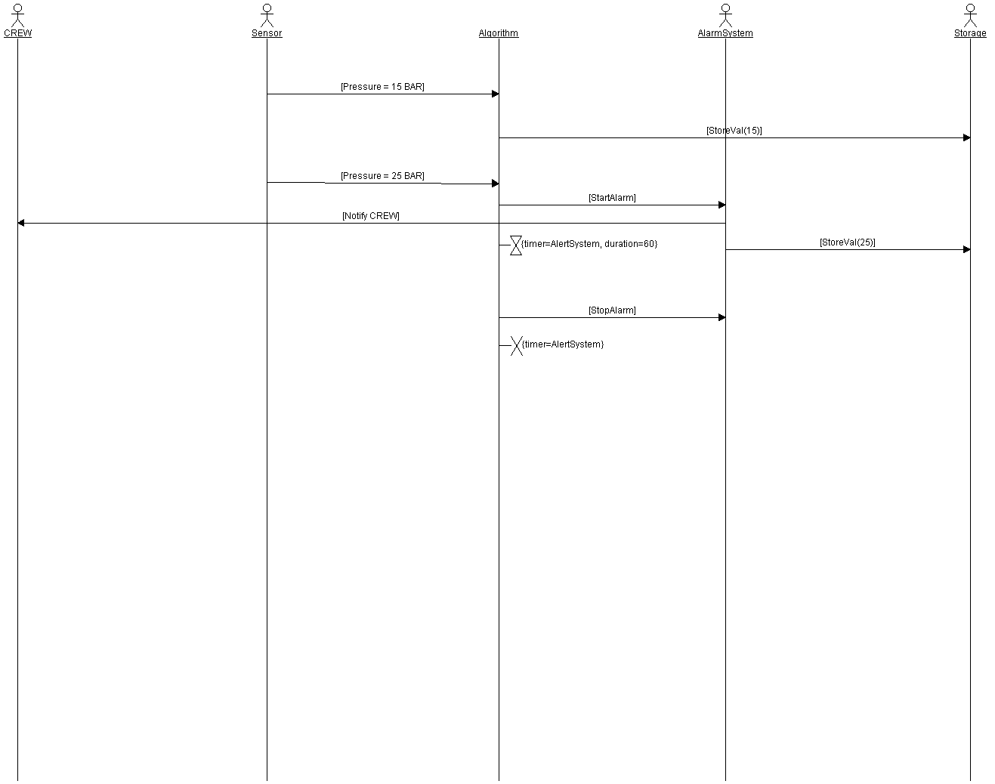
Time sequence diagram

Slide 17
System design

Slide 18
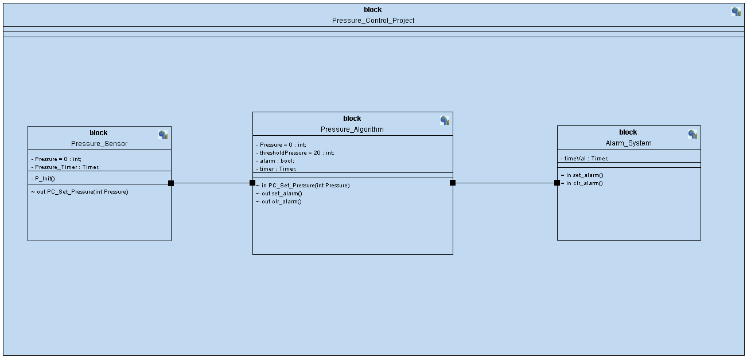
Block diagram

Slide 19
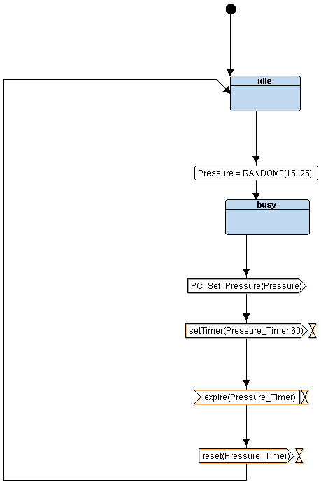
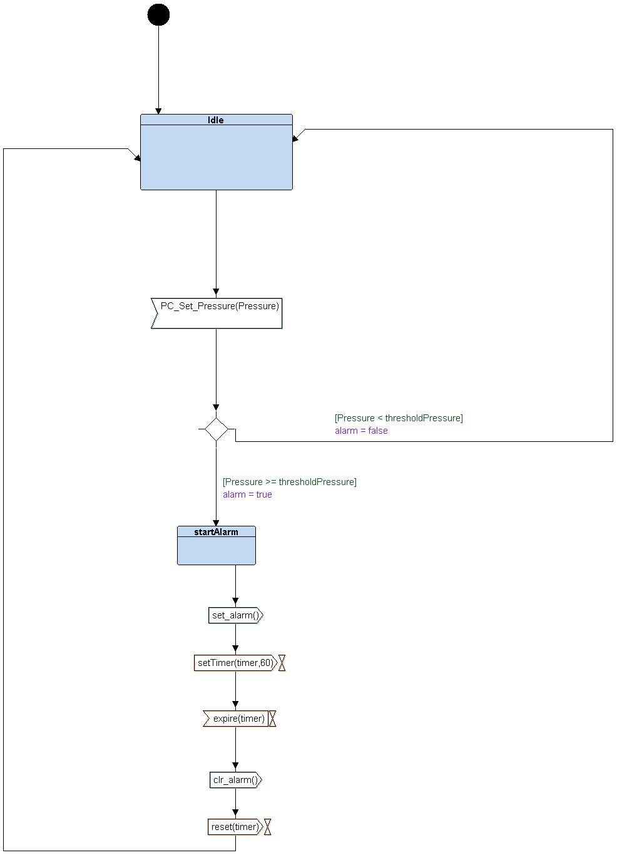
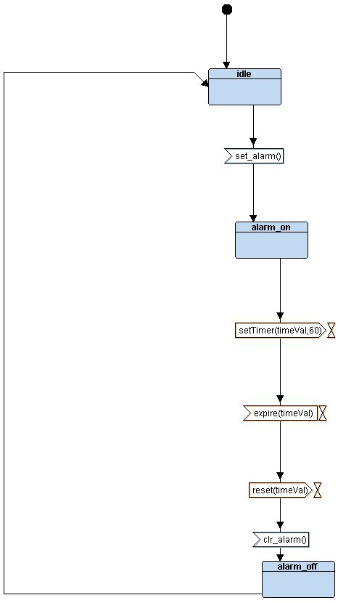
Systems within block diagram

